Slide 1

Signature Verification System
A Django-based Solution for Real vs Forged Signature Detection

Slide 2
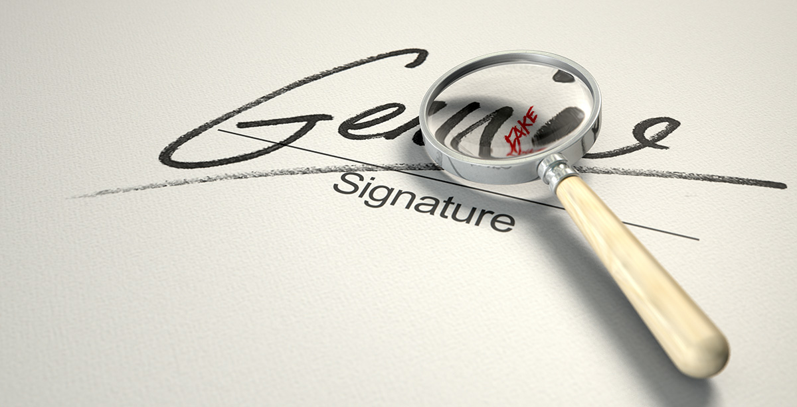
Signature fraud is a common issue in banking, legal, and
other industries. Manual verification is time-consuming
and prone to errors.

Slide 3
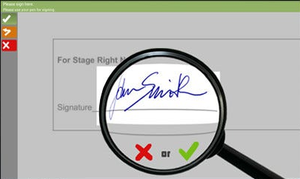
Objective
To develop a reliable and efficient system to detect whether a signature is real or forged using deep learning techniques
Key Objectives:
Accuracy in detection
User-friendly interface
Minimal processing time

Slide 4
Django: The Framework for Our Project
Fast Development:
Built-in tools for quick prototyping (user authentication, forms, etc.).
Robust Security:
Built-in protections against common web vulnerabilities (e.g., CSRF, SQL injection).
Scalability:
Easily handles growing traffic and complex features.
Easy Integration:
Seamlessly integrates with machine learning models for real-time processing.
Simplifies Development
Secure &
Scalable
Strong Security
Built-in Features
Community Support

Slide 5
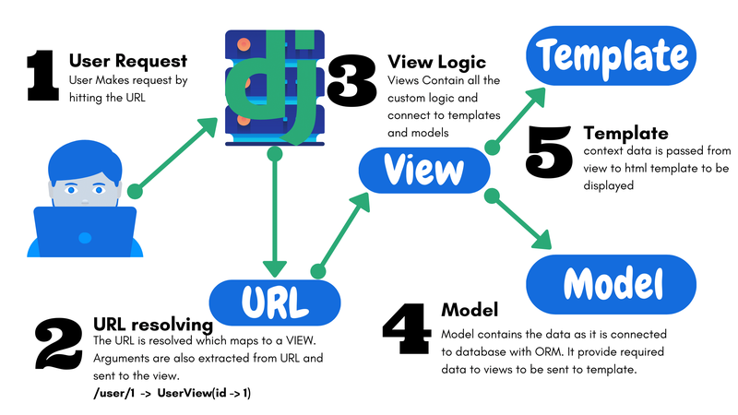
Working of Django

Slide 6

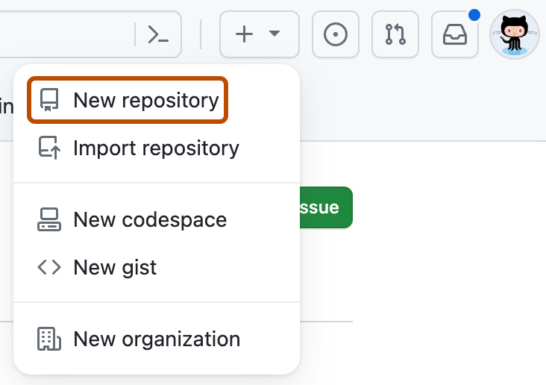

Why GitHub?
Version Control:
GitHub helps track and manage changes to the project over time, enabling collaboration.
Collaboration:
Supports seamless collaboration with teammates through pull requests and issues.
Open-source Community:
Access to a vast community of developers, enabling learning, sharing, and improving the project.
Project Visibility:
A public repository increases visibility and showcases the project to potential employers and collaborators.
Integration with CI/CD:
GitHub integrates well with continuous integration tools, enhancing project development and deployment.

Slide 7
GitHub Repository for Django Projects
Version Control: Tracks changes in code, allowing rollback to previous versions if needed.
Collaboration: Enables multiple developers to work together seamlessly.
Backup: Acts as a secure, remote backup of the project.
Code Sharing: Simplifies sharing code with clients or team members.
Documentation: Helps document the development process with commit messages.
Issue Tracking: Allows managing and tracking bugs or feature requests.
Integration: Supports CI/CD pipelines for automated testing and deployment.

Slide 8
Neural Networks used
Recurrent Neural Network
Convolutional Neural Network (CNN)
Bidirectional RNN (Bi-RNN)
Bidirectional LSTM
Convolutional Recurrent Neural Network(CRNN)
CNN: Extracts spatial features from signature images.
RNN: Analyzes sequential stroke patterns.
Bi-RNN: Captures context by processing strokes in both directions.
CRNN: Combines CNN for feature extraction and RNN for sequence analysis.
Bi-LSTM: Processes sequences in both directions for better context.

Slide 9
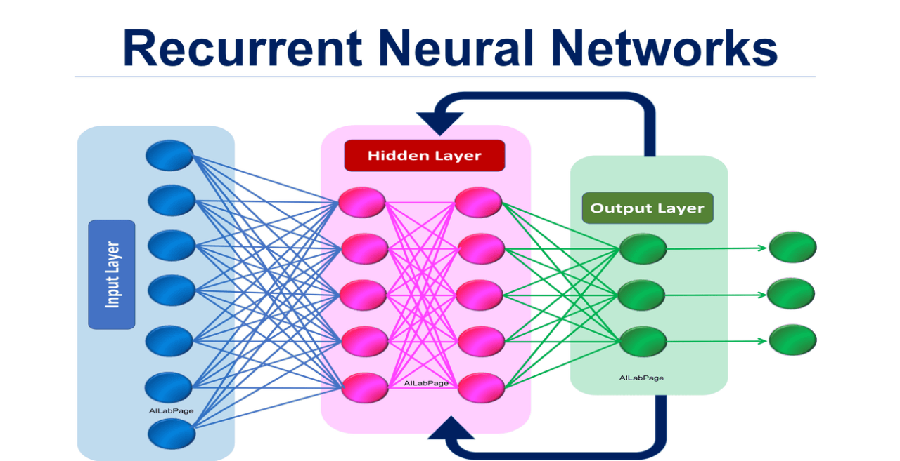
Recurrent Neural Network in signature verification
Sequential Data Processing:
RNN processes the sequence of strokes in a signature, recognizing the flow of writing.
Captures Temporal Dependencies:
Learns dependencies over time, allowing the model to understand the order of strokes.
Signature Dynamics:
Helps identify variations in the writing style, such as speed and pressure, which are crucial for verification.
Improved Accuracy:
Enhances model performance by analyzing the temporal relationship between each stroke in the signature.

Slide 10
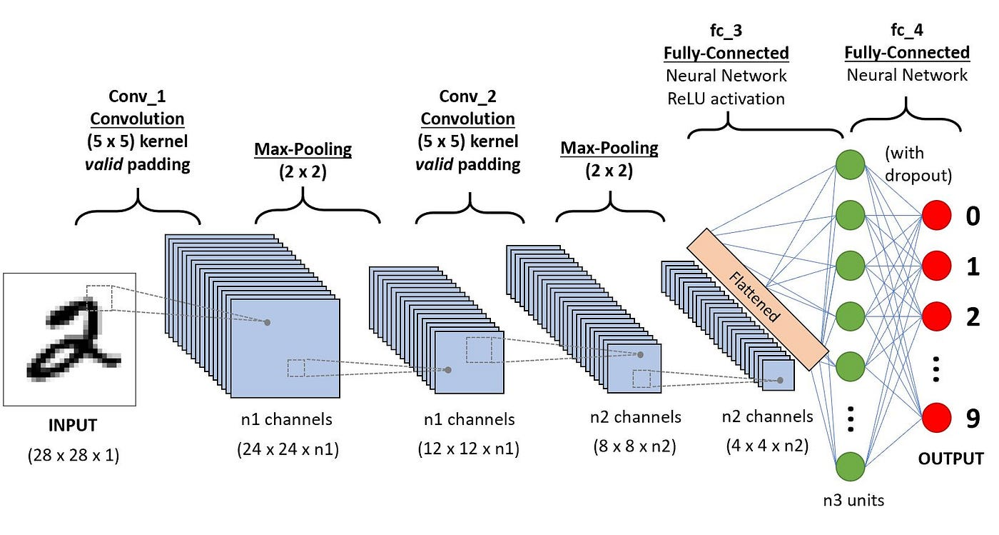
Convolutional Neural Network (CNN)

Slide 11
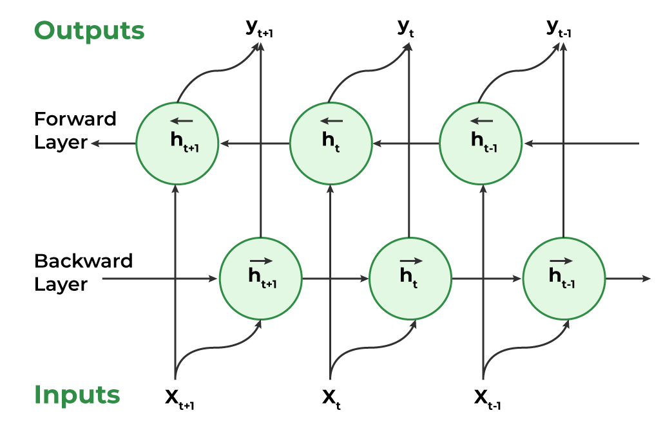
Bidirectional RNN (Bi-RNN) in signature verification
Bidirectional Processing: Analyzes the sequence of signature strokes in both directions.
Captures Context: Helps understand dependencies in the signature flow, enhancing feature recognition.
Improves Accuracy: Provides better context for verifying subtle signature variations.

Slide 12
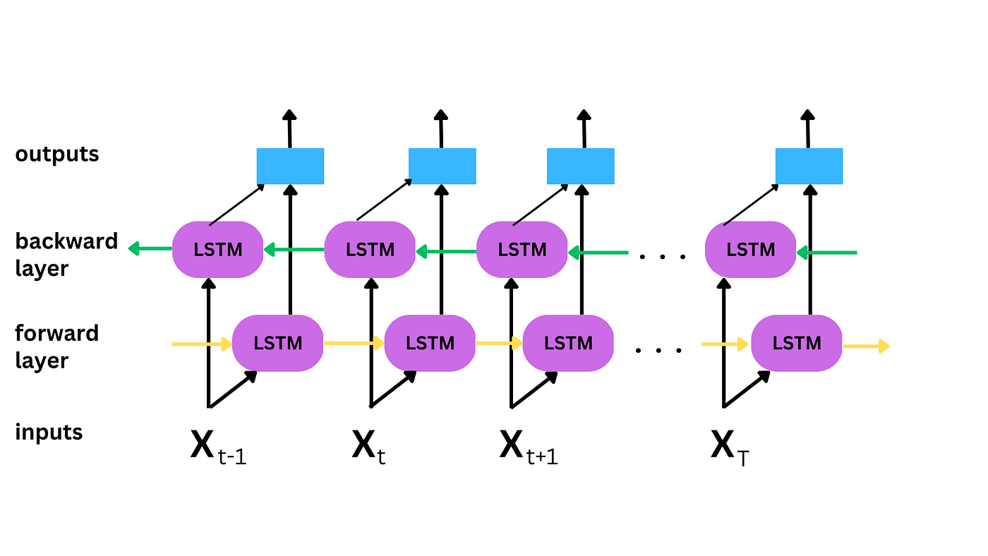
Bidirectional LSTM in signature verification
Bidirectional Processing: Analyzes signature strokes in both forward and backward directions.
Memory Cells: Retains important features across the sequence of strokes.
Contextual Understanding: Improves recognition of subtle variations in signatures for better accuracy.

Slide 13
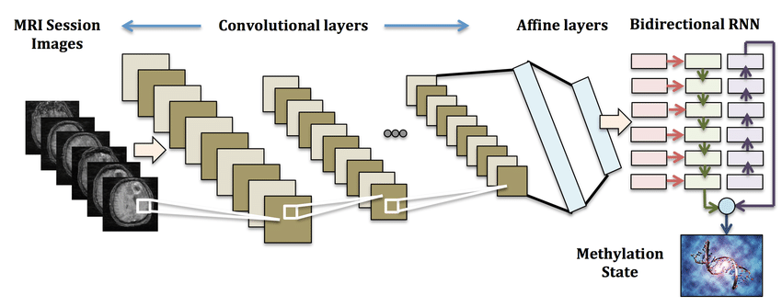
CRNN in Signature Verification
Combination of CNN and RNN: Extracts spatial features with CNN and analyzes stroke sequence with RNN.
Improves Feature Learning: Captures both visual patterns and temporal dependencies in signatures.
Enhances Accuracy: Provides better recognition by considering both image features and writing flow.

Slide 14
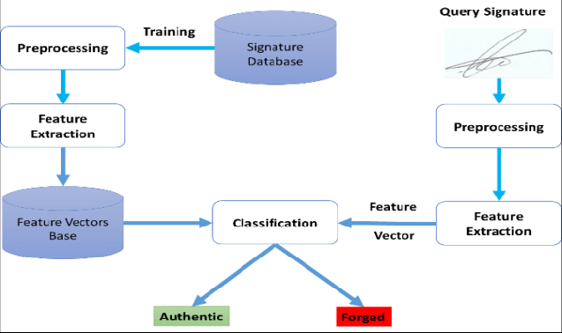
System
Architecture

Slide 15

Steps to Operate the Signature Verification Model:
MODEL
User uploads a signature image.
The system preprocesses the image.
ML model predicts the authenticity (real or forged).
The results are displayed on the web interface.
Access the System:
Open the web interface and log in using your credentials.
Upload the Signature:
Select and upload the signature image through the upload section.
Processing:
The system preprocesses the image for analysis.
Verification:
The ML model predicts if the signature is real or forged.
View Results:
The prediction is displayed on the web interface with detailed output.

Slide 16
User registration and login
Secure image upload functionality
Real-time signature verification
Results display with prediction and accuracy
Intuitive and responsive web interface

Slide 17
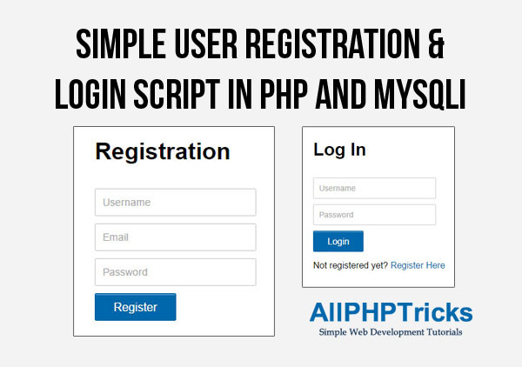
USER REGISTRATION AND LOGIN
User Registration:
Signup page for users to create an account with details like email, password, and personal information.
Form validation ensures correct input (e.g., password strength, unique email).
User Login:
Login page for registered users to authenticate using email and password.
Secure authentication with session management to maintain login state.

Slide 18
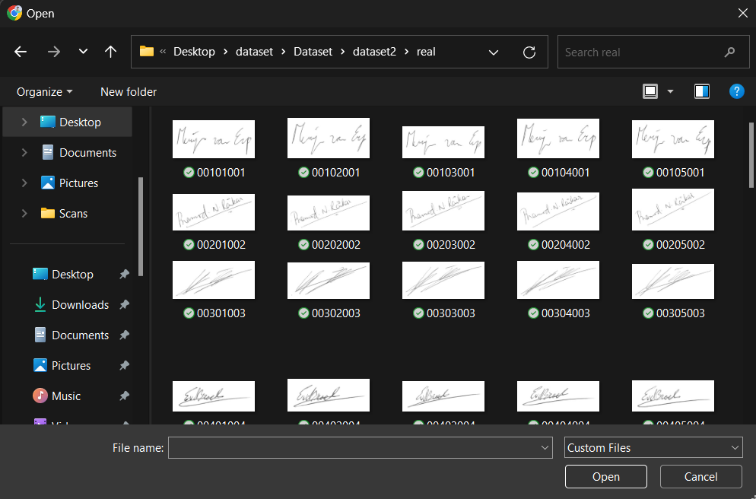
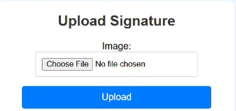
Secure image upload functionality
File Validation: Only allows valid image formats (JPG, PNG) and restricts file size.
Storage: Secure storage in dedicated directories or cloud services.
Security: Ensures file name sanitization and requires user authentication.
Processing: Optional resizing and compression for better performance.

Slide 19

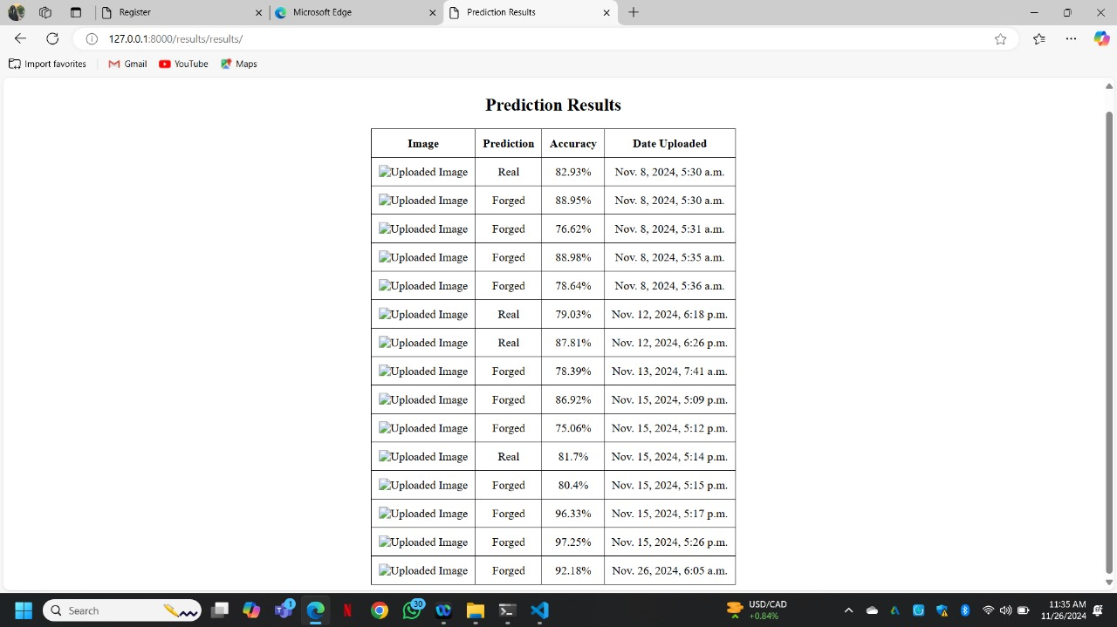
Real-time signature verification
Instant Authentication: Verifies signatures as they are captured or uploaded.
Model Integration: Uses trained models (e.g., CNN, RNN) to analyze the signature in real-time.
Fast Processing: Quick and efficient processing to minimize user wait time.
Accuracy: Ensures reliable verification by comparing the real-time signature with stored data.

Slide 20
Intuitive and responsive web interface
HOME
User-Friendly Design: Easy navigation with clear instructions and feedback.
Responsive Layout: Adapts seamlessly to different screen sizes (desktop, tablet, mobile).
Interactive Elements: Real-time updates and smooth transitions for a better user experience.
Efficient Workflow: Simplified steps for users to upload, verify, and view results.
REGISTER
& LOGIN
IMAGE UPLOAD
PREDICTI-ONS

Slide 21

FUTURE GOALS
Improve Accuracy: Enhance model performance with additional training data and advanced algorithms.
Real-time Processing: Enable faster and more efficient real-time signature verification.
Expand Dataset: Include more diverse signature samples to improve robustness across different users.
Integrate with Other Systems: Integrate the signature verification system with banking or legal applications for seamless use.
User Interface Enhancements: Make the web interface more intuitive with additional features and better user feedback.

Slide 22





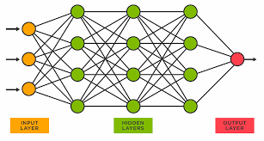
CONCLUSION
Efficient and Secure: The project provides a reliable, fast, and secure method for signature verification.
Deep Learning Integration: Utilizes CNN, RNN, and Bi-LSTM models to accurately identify real and forged signatures.
User-Friendly: The intuitive web interface enhances user experience with seamless interaction.
Future Potential: With continuous improvements, the system can be integrated into various industries, offering a robust solution for identity verification.

Slide 23


